Slide 1

Edge Systems
A comprehensive commonsense approach to today’s Oilfield

Slide 2
Edge Experience
Edge has been mudlogging since 1964, one of the first logging companies in he US headquarted in Ok City
We hire from community colleges, to the Colorado School of Mines, and visit BYU twice a year, giving presentations and an opportunity to get into the Oil field from the ground up
Our best loggers are Derrick Hands, or Geologists, who enjoy this way of life. The ones who show initiative, we bring into our geosteering Team and actively find them jobs with Operators like Conoco and Exxon
We also know, that the Experience that we give to the younger generation, is a lasting memory, and for those who want more, we are very proud they chose us to help start their future.

Slide 3

EDGE – Client Models
  EOG Model
  16 rigs
  Remote gas footprint
  Only log specific wells (pilots, new benches, etc.)
  On-Demand as needed
  BPX Model
  5 rigs
  Remote gas Footprint
  Mass Spec on all laterals
  Manned logging on high-profile wells
  Chevron Model
  10 rigs
  Manned logging 1st well; remote remainder
  SLB Pneumatic Constant Volume Trap
  Mass Spec in structurally complex areas
  Endeavor Model
  10 rigs
  Performance-based geosteering
  On-demand logging
  Advanced sample collection (RevoChem; XRF/XRD)
Proven
Repeatable
Reliable
3

Slide 4
SLB US Land Partnership
Our partnership allows us to offer all of SLB’s Geological Services on US Land
Our partneship was born out of SLB’s desire to find a large Mudlogging Co in the US, with the best reputation.
This partneship has allowed us to finetune services that are now specific to US Land
SLB allows us to use a broader range of equipment and services unrivaled in the US, and this has allowed us to attract the most talented and experienced hands, this industry has to offer

Slide 5
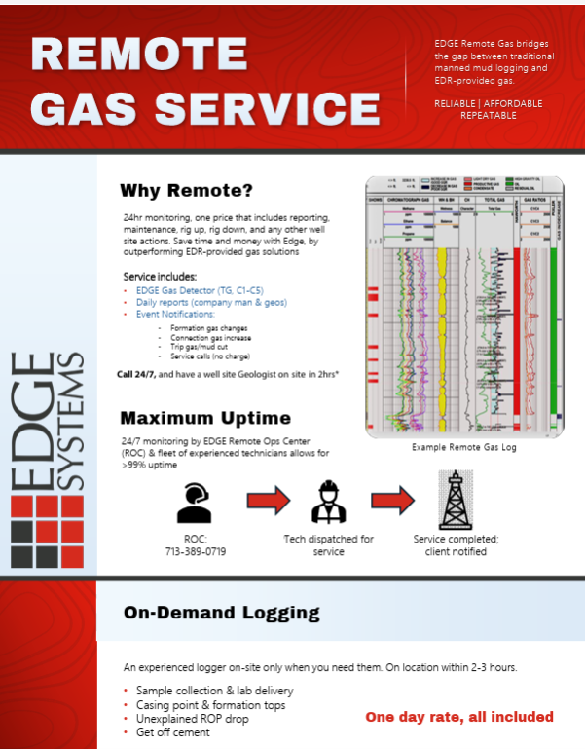
EDGE/SLB Partnership
Through SLB and Edge, we have been able to collaborate and offer Remote Gas detection, with Mass Spec

Slide 6
No More Contact Confusion
(713) 389-0719, the only number you neeed
From XRD on-Site, to Geosteering, you only need to know one number, that is manned by our Remote Operating Center 24/7/365 and we will handle all of Geological Services Needs
We have found that there is no need for confusion, or 3 points of contact. We have a Remote Center, watching every well, and is locked in on what is happening with our clients and their wells.
Plus removing barriers, and giving you direct contact with the professionals that are preparing your reports and dispatching Techs to make sure your data is correct, and reliable

Slide 7
Interpretations
Post well interpretations will be done on the following services
Mass Spec, XRF, XRD, Real Time Isotope
Once the well has TD and we have had time to prepare our post well interpretation of the data, we will set up a meeting, in person or remote
This is a great time to see your data, from a Mass Spec driven analysis
We will also prepare a report that includes your Gamma, SS file, seismic and usually horizontal view, all on the same slide.
This allows us to give you a visual aid to show you what is happening down hole and help tell the story that can be easily shared with other departments

Slide 8
Edge Interpretations Guide
After we conclude our interpretation we will send you the file with our findings attached
We will also include the Edge Systems interpretation Guide, so you can follow along, and see the ratios and formulas that we used to guide our final interpretation. Some Mass Spec ex:
Fault and Fracture, Depletion, Compartmentalization, Water Contact, Bit metamorphism, Fluid Composition, Wetness and Balance and Target Validation
The final interpretation can include none or all of these scenarios

Slide 9
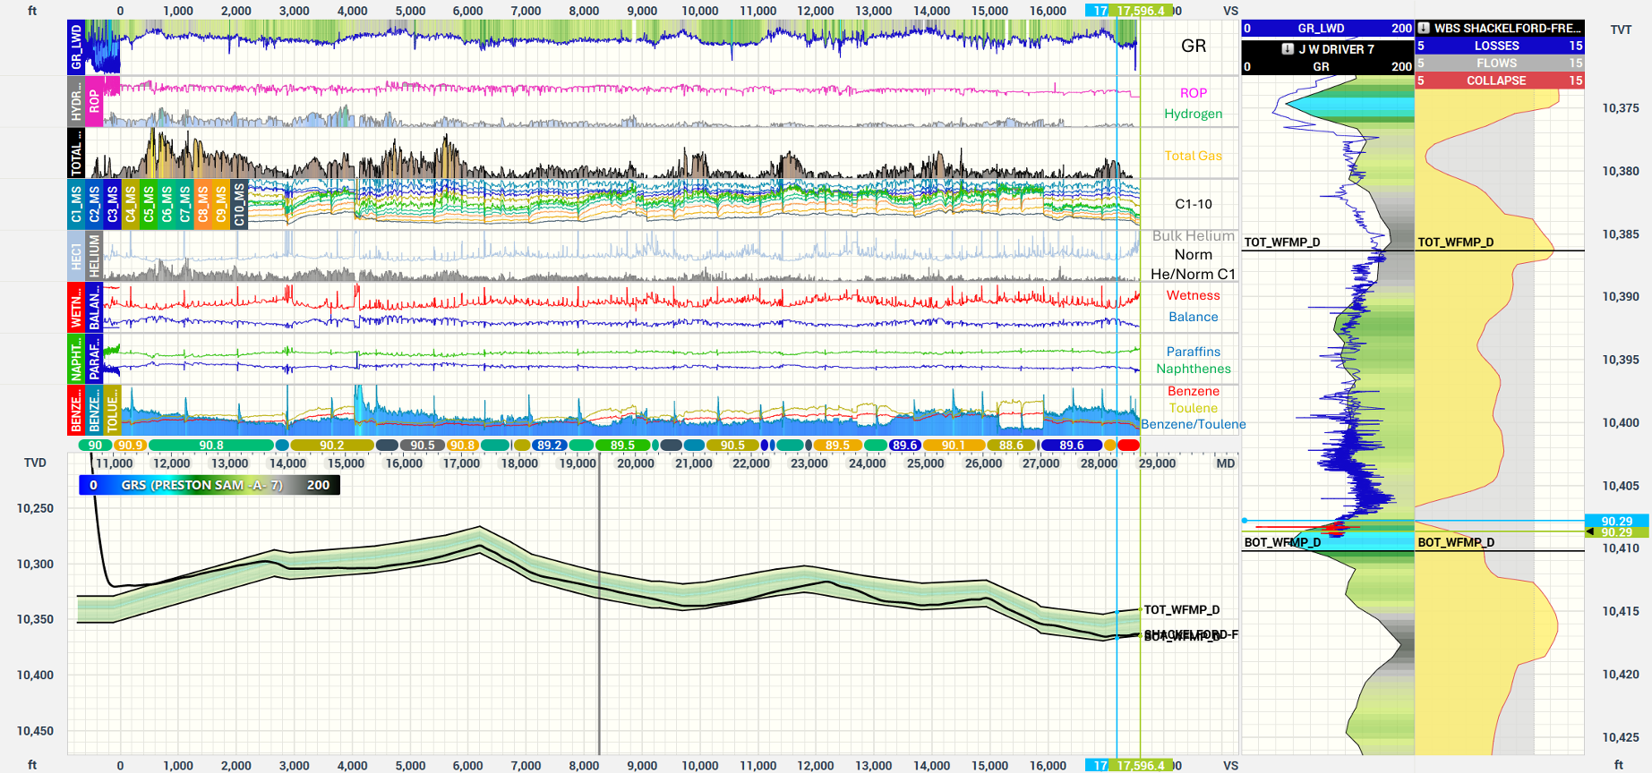
Interpretation Example

Slide 10
Rig Monitoring
When you use Edge to be your geological service vendor, we will reach out to Pason, Totco or whoever your EDR service provider is.
We will ask for permission to see the rig data, so that we can see what depth you are at, and use your GeoProg depths, to remind us and your operations department, when we need to be rigging up on location.
We have several Operators who rely on us to let them know when we need to be on location and it is just another service on our end that makes life easier for you.
Our Remote Operating Center is manned 24/7/365

Slide 11
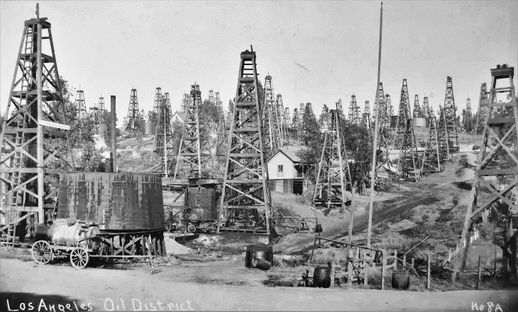
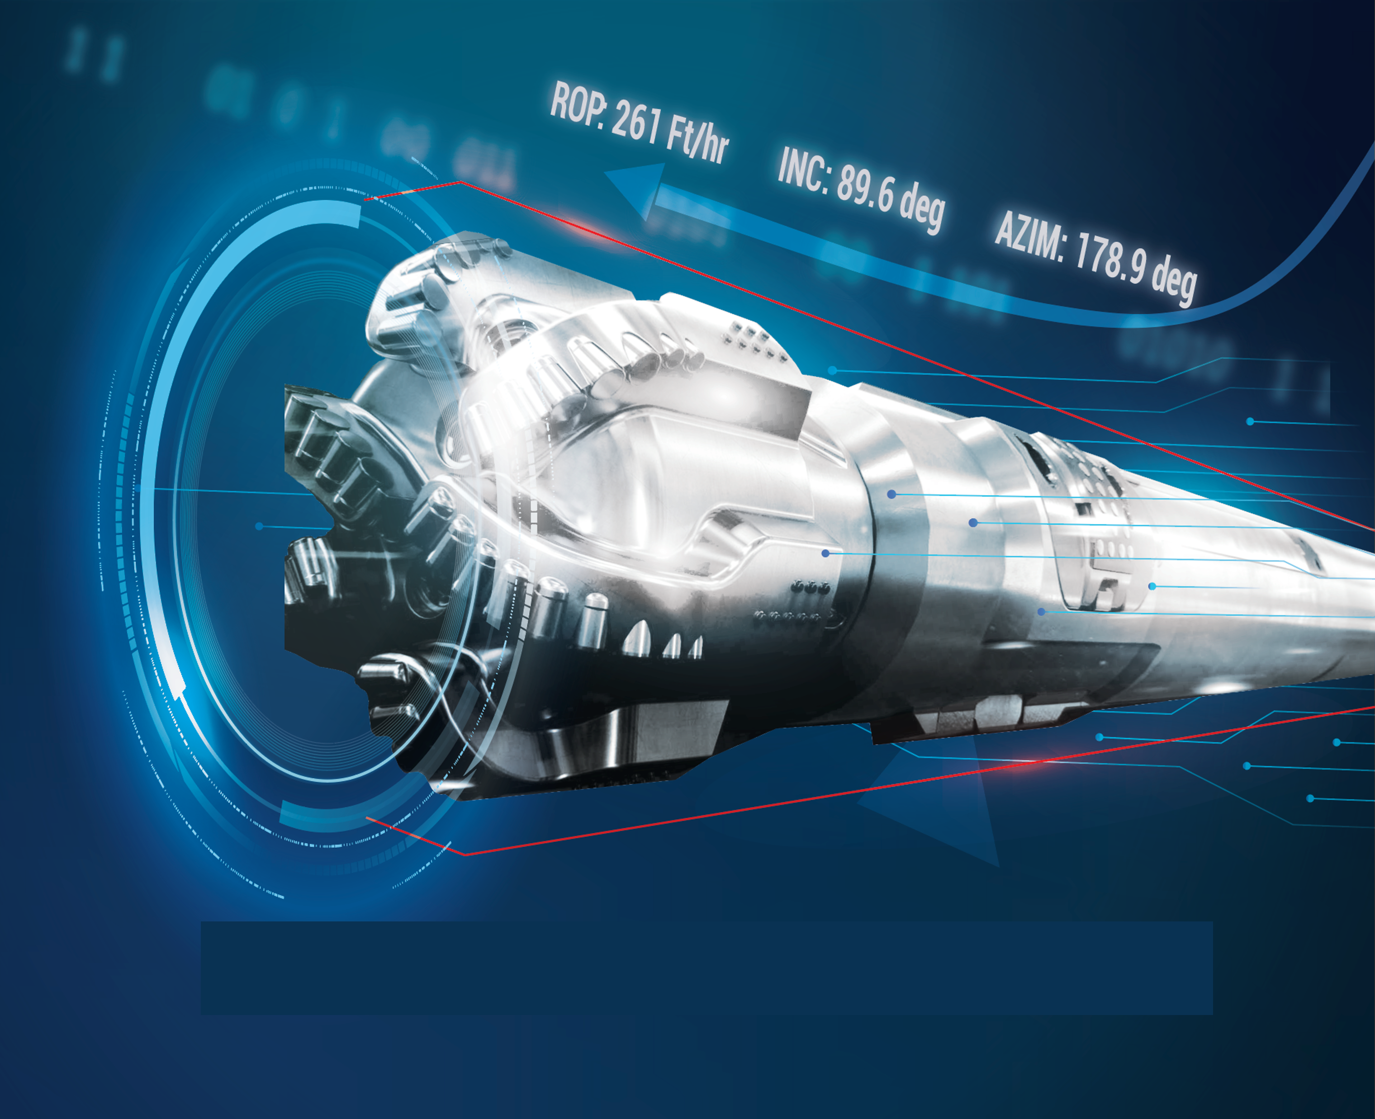

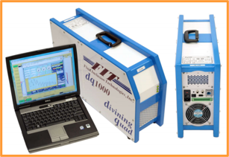
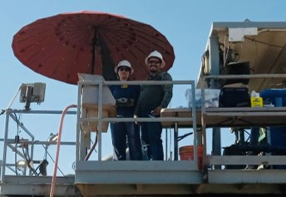
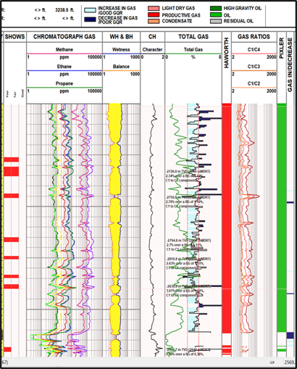
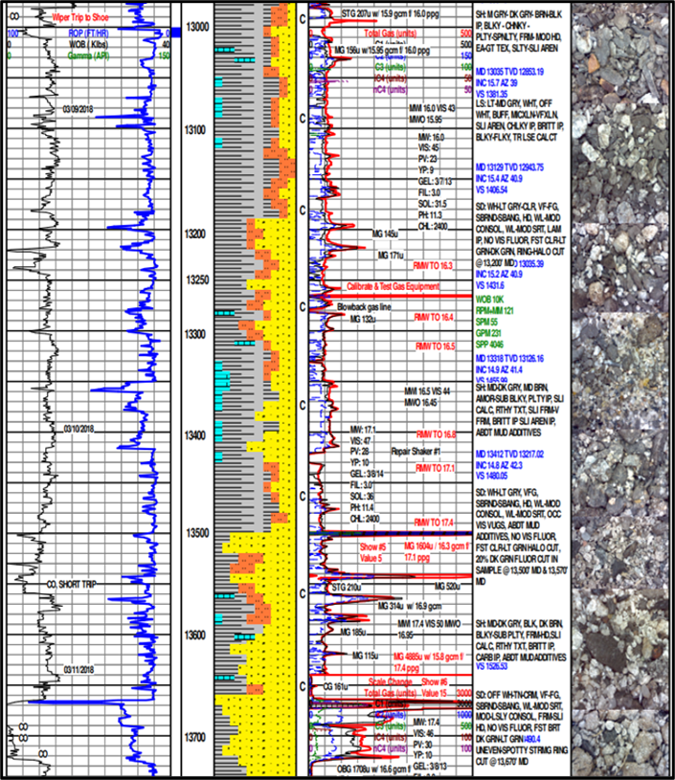
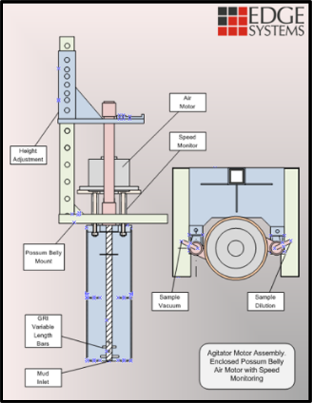
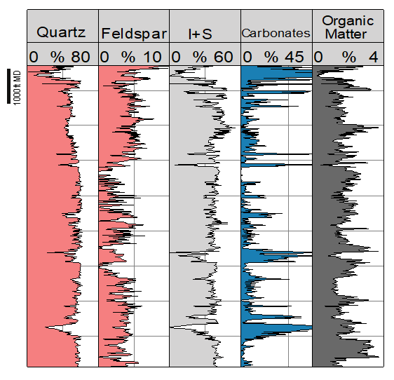
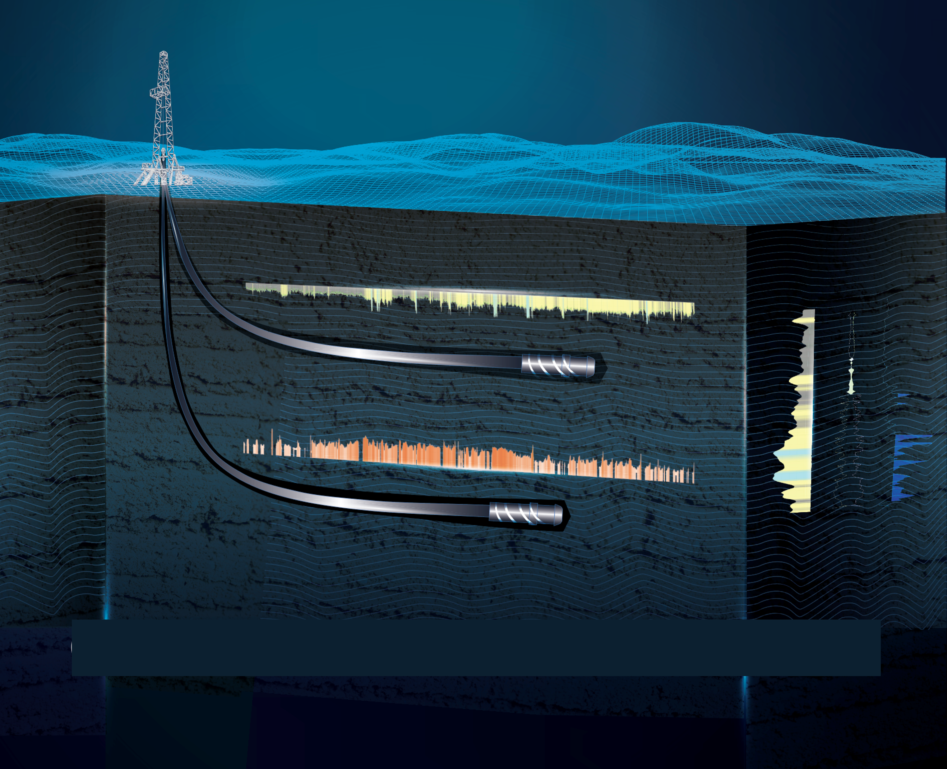

The Oilfield Transition
Specialized Sampling
Remote Gas
Mudlogging
On-Demand Mudlogging
Geosteering
XRF/XRD Sampling
Mass Spec
Professional Staffing & Placement
Wellsite Logistics
EDGE
System
24/7 ROC
Daily Report
Event Notifications
On Demand
Traditional
Mudlogging
EDGE Remote Service
Remote Features
Lagged dataset
Mass Spec
No service charge
EDR Provider
No data acquisition
Any collection → science well
11

Slide 12
One SOP on all Services
In the US oil and gas basins over time have developed certain SOP’s for gas calibrating, recording ROP and importing data on the log.
This service, offering the same SOP in every basin, on every well and gives you the ability to use your data, calibrated exactly the same, ROP measured the same, gamma imported and found on the exact same area of the log, Show Reports, and Pics all in the same spot
We offer the ability to compare apples to apples, with our calibrations and scales annotated on the log, using the exact equipment, exact color codes, everywhere in the US.
Best Practice SOP’s for: Carbon Capture, Geothermal, High Pore Pressure, Air drilling , Wild Cats, Evaluations, unconventionals and Conventionals

Slide 13
Nationwide Geology Coverage
Having size has its advantages
We have experienced personnel that cover the entire United States.
No matter what type of rig you have or what drilling technique you are using to reach your target formation, we have the experienced hands that can be utilized to help you drill a faster, safer well.

Slide 14
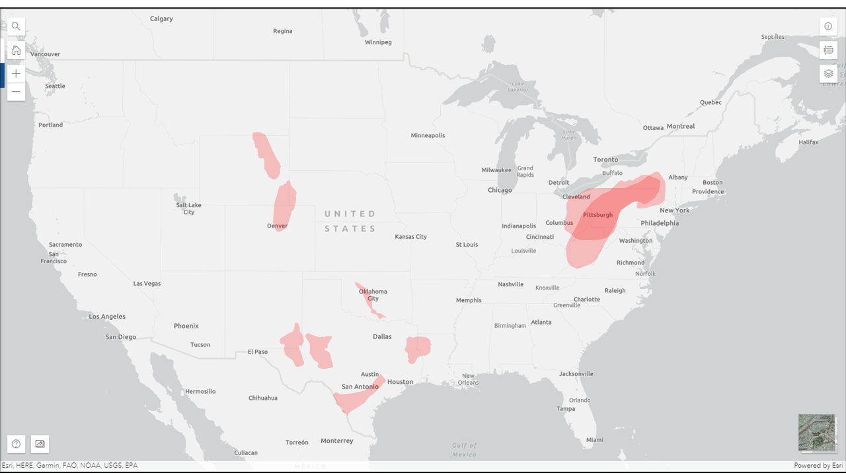












EDGE Services
Powder River
DJ Basin
Utica
EDGE services utilized in every major US basin
SCOOP/STACK
Marcellus
Permian
Haynesville
Eagle Ford
14

Slide 15
EDGE Systems Commitment
Edge Systems is committed to meeting or exceeding customer requirements and expectations and enhancing customer satisfaction through continual improvements of its products, services, and the quality management systems

Slide 16
The Multiple Vendor Issues
Calibrations: Be sure to express exactly what your Max Gas should be, and have each vendor send in a calibration check list with the morning report. Each unit should have 1%,2% and 20% methane to calibrate with, if running a FID, they will need a 7 gas mix.
Maintinance: The Operator must ask for the vendors maintenance reports. Many times the equipment is left in the field, with faulty sensors
Quality Control: How does your vendor keep track of Quality
Instrument Sensitivity: What is the +/- of your gas equipment in ppm or percentages
Interpretations: Do you have a guide to help me understand how you came to these conclusions, while using my data
Experience: Can you share resumes on loggers, geosteerers who have worked this area, and do they have references
Units of measurement: 1% = 10,000 Units, ROP Minutes per Foot, scales, 1’, 2” and 5” log, with ROP and Gas scales annotated at the top of every page, and all scale changes correlated to the MD, at the bottom of the log.
Everyone is trying the best they can, a quick call for a geological prespud meeting can make a world of difference

Slide 17
Merging All Data Streams
ROP
Gas
Gamma
Survey
Mass Spec
Isotope Detection
Geosteering
MD/TVD
Every curve, streaming into our database and available in real time

Slide 18
SOP’s on all Drilling Rigs
We cannot stress the or emphasize the importance of sharing your SOP with the Client, and staying true to your Operating Procedures
Edge has gone through years of evaluating best practices on all types of wells.
Many times it is not the data that you see today that is important, it is the data that you are using from a well that was drilled and logged 20 years ago.
Here are examples of drilling SOP’s derived from experience on each type of drilling Rig or Well:
SOP’s: Carbon Capture, Geothermal, High Pore Pressure, Air drilling , Wild Cats, Evaluations, unconventionals and Conventionals

Slide 19
Profitability
You need to know when you are working with a partner, that both of you are profitable and are making decisions to help drill the best well possible
Profitablity allows the Operator to have confidence in his vendor, that his decisions will not be made purely by revenue or extra days and can see the big picture.
Edge Systems is a vendor partner, who has an employee owned business model, meaning that everyone has a part in this job and we all do better when everyone is giving their best…
Being progitable also means being accountable to your client,and your employees, meaning, we do not shy away from a job, or critisizm and we expect our partner to work as hard as we do

